Slide 1
ML OPs
David Pratap

Slide 2
Contents ML OPs
DAY1- Intro to ML and Demo of Medical diagnostic Model
Day2 Intro to MLOps deployment of Medical Diagnistic App
Day3- Demo of Deep Learning Computer Vision App

Slide 3
Intro to ML

Slide 4
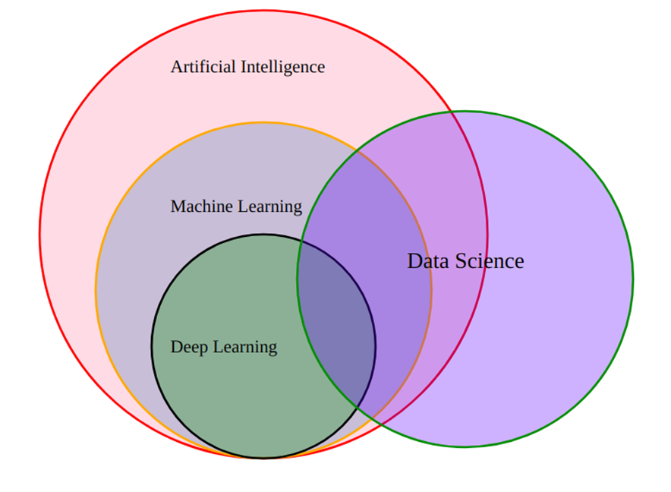
What are AI, ML and DS?
Notes:
AI- artificial Intelligence is a huge set of tools for making computers behave intelligently
ML- Machine Learning is the most prevalent subset of AI followed by Robotics
DS- Data Science deals with discovery and creating insights from data. ML is often an important data science tool.
DL- Deep Learning ,aka neural networks is a special area of ML and is best when inputs are images or text

Slide 5
What is ML ?
It is software/program that can learn from experience(data)
ML gives computers the ability to learn from data without being explicitly programmed (`Arthur Samuel’ , 1959)

Slide 6
Traditional programming vs ML
The Output of ML is the Model

Slide 7
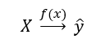
How does ML model look like in practice ?
Model -→ A statistical representation of a real world process based on data
X→ Training data also called features
y→ prediction also called labels
f(x)→ML algorithm for Training into a Model

Slide 8
What is ML?
We define ML as a set of tools for making inferences and prediction from data
Often inferences and prediction work together, inferences help make prediction
ML is interdisciplinary mix of statistics and computer science
Learn pattern from existing data and apply to new data , e.g learn to detect spam from historical data and use that knowledge to identify spam in new data

Slide 9
Fundamental difference between stats & ML
Machine learning tends to deal with large complex datasets such as dataset of millions of images each containing 1000s of pixels
Classical statistical analysis such as Bayesian analysis would be impractical for such datasets

Slide 10

Pop quiz
State True or False
A) To make predictions from ML model you need data
B) ML finds patterns in existing data & apply to new data
C) ML can only predict what will happen and not explain why something happens
D) ML’s applications is not limited to one type of problem/domain
TRUE
FALSE

Slide 11
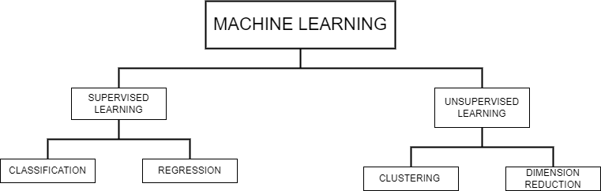
THE ML DIAGRAM
Notes:
Regression- when goal is to predict a numerical variable like House Price
Classification- when goal is to predict a class like Fraud/Not Fraud

Slide 12
ML concepts
Supervised Learning
→Training data has both features and label
→ features=predictor variables=IVs
→ target variable=response variable=DV
→given a set of features/label pairs find a mapping that predicts the label associated with previously unseen input .
Unsupervised Learning – Training data has only features i.e we don’t know the right answers
→eg. Anomaly detection
→Clustering – dividing data into groups based on similarity
→given a set of feature vectors( without labels) group them ‘natural clusters( labels for the groups)

Slide 13
Goal of Supervised Learning
Automate time consuming or expensive manual task , eg. Doctor’s diagnosis
Make predictions about the future→ will a customer click on the ad or not
Need labelled data
→ get historical data with labels
→experiment to get labelled data ( eg. A/B testing to check no. of ad clicks)
→crowd sourcing labelled data , eg. Recaptcha does for text recognition
GOAL: HAVE DATA WITH RIGHT PREDICTION LABELS SO THAT WE CAN TRAIN A MODEL TO PREDICT ACCURATELY FOR NEW DATA

Slide 14
Supervised Learning in python
We will use scikit learn/sklearn ( an industry standard package )
→ integrates well with SciPy package
Other libraries
→ tensorflow
→ Keras

Slide 15

Pop quiz
Which is a classification problem
Using labeled financial data to predict whether the value of a stock will go up or go down next week.
Using labeled housing price data to predict the price of a new house based on various features.
Using unlabeled data to cluster the students of an online education company into different categories based on their learning styles
Using labeled financial data to predict what the value of a stock will be next week.

Slide 16
Data Scientist Toolkit
CLASSIFICATION
Logistic Regression.
k-Nearest Neighbors.
Decision Trees.
Random Forests
Support Vector Machine
Naive Bayes.
Gradient Boosting Trees
AdaBoost
XGBoost
REGRESSION
Linear regression
Lasso Regression
Ridge Regression
Decision Tree Regressor
Support Vector Regression
Random Forest Regressor.
Clustering
K-means
Hierarchical clustering
DBScan

Slide 17
Model evaluation
To compute model evaluat metrics we should use data the model has not seen before.
Split the dataset into training and testing data .
Fit/train the classifier on the training set .
Make the predictions on test set .
Compare predictions with known labels

Slide 18
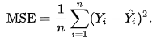
Model evaluation
For Classification
For Regression
Accuracy – In classification accuracy is a commonly used metric. Accuracy is the fraction of correct predictions
Precision- It is the model’s probability to convert. How accurate are the model’s predictions
Recall- model’s ability to recall the genuine positive values. It’s a measure of the models reach, ie higher the recall higher the reach
Coefficient of determination(R2)- a statistical measure of how well the data fits the regression line
Mean square error (MSE) – It is a measure of the mean of the squared error

Slide 19
ML Life cycle Steps
DESIGN
1.Data Acquisition
2.Exploratory Data Analysis – univariate & bivariates & correlations
3. Data Preprocessing
DEVELOPMENT
4. Model Building with training data – Fit the model
5. Model evaluation with test data – Check the metrics
6. Model optimization-Hyperparameter tuning
7. Model interpretation
DEPLOYMENT
8. Model Deployment
9. Monitoring

Slide 20
Pop Quiz : Classify as Design, Development, Deployment
Do an experiment comparing two algorithms
Make an overview of potential data sources you need
Deploy the machine learning model in the business process
Talk to your business manager/client as to how accurate the ML model should be
Combine two features to produce a new feature for your ML model
Do a weekly check of you ML model Predictions

Slide 21
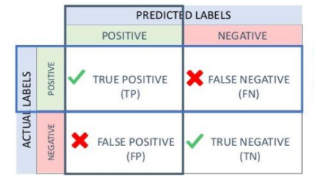
Evaluation Metrics for Classification- Confusion Matrix
Precision and Recall are metrics that are used for evaluating the performance of a classification algorithm. These can be understood more clearly using a confusion matrix as shown beside.
Precision is the proportion of true positives among those predicted positives. So Precision is a % expressing the accuracy with which positive classes are predicted. As a formula Precision = TP/(TP+FP)
Recall on the other hand is the proportion of true positives among those that are actually positive. So recall is a % expressing the capacity of the model to recall positive values. As a formula Recall =TP/(TP+FN)
These measures are very useful in a marketing scenario

Slide 22
Pop Quiz
Which of the following situations looks like an example of overfitting?
Training accuracy 50%, testing accuracy 50%.
Training accuracy 95%, testing accuracy 95%.
Training accuracy 95%, testing accuracy 50%.
Training accuracy 50%, testing accuracy 95%.

Slide 23
Algorithms for Classification
K Nearest Neighbors
Logistic Regression
—---------------------------------
Decision Trees
Voting Classifier
Bagging Classifier
Random Forest
Naive Bayes
—----------------------------------
Gradient Boosting
Adaboost Classifier
XgBoost Classifier
SVM

Slide 24
KNN
The k-nearest neighbors (KNN) algorithm is a supervised machine learning algorithm.
KNN assumes that similar things exist in close proximity. This implies that similar data points are close to each other. KNN calculates the distance between points on a graph to decide similarity
The distance can be of any type, e.g., Euclidean, Manhattan, etc.

Slide 25
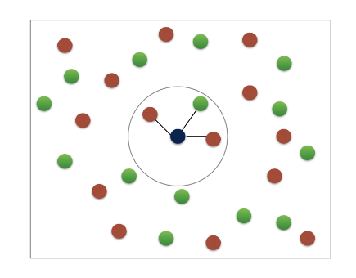
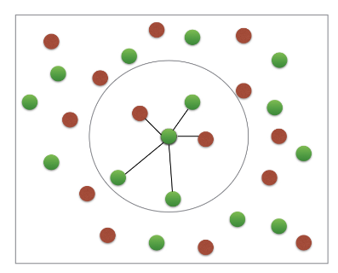
K- Nearest Neighbors
Basic Idea : predict the label of a data point by
Looking at “k” closest labelled data points
Taking a majority vote

Slide 26
KNN Advantages and Disadvantages
Advantages
Very easy to implement.
This algorithm can be used for both classification and
Regression.
Since data is not previously assumed, it is very useful in cases of nonlinear data.
The algorithm ensures relatively high accuracy.
Disadvantages
It is a bit more expensive as it stores the entire training data.
High memory storage requirements for this algorithm.
Higher sets of values may lead to inaccurate predictions.
Highly sensitive to the scale of the data.

Slide 27
KNN Uses
The following are some of the areas in which KNN can be applied successfully:
KNN is often used in banking systems to identify if an individual or organization is fit for a grant or a loan based on key characteristics.
KNN can be used in Speech Recognition, Handwriting Detection, Image Recognition, and Video Recognition.
A potential voter can be classified into categories based on characteristics (like “voter” or “non-voter”) for elections

Slide 28
Random Forest
Random forests are a form of ensemble learning where we use the concept of bagged trees
Random forests provide an improvement over bagged trees by way of a random small tweak that decorrelates the trees.
As in bagging, we build a number of decision trees on bootstrapped training samples
But when building these decision trees, each time a split in a tree is considered, a random sample of m predictors is chosen as split candidates from the full set of p predictors. The split is allowed to use only one of those m predictors. A fresh sample of m predictors is taken at each split, and typically we choose m ≈ √p

Slide 29
PROS of Random Forest
It reduces variance as taking many trees from n bootstrapped samples and averaging their prediction leads to lower variance
It also reduces bias in the dataset by decorrelating the trees which is a problem with imbalanced datasets
Random forests overcome this problem by forcing each split to consider only a subset of the predictors. Therefore, on average (p − m)/p of the splits will not even consider the strong predictor, and so other predictors will have more of a chance. We can think of this process as decorrelating the trees, thereby making the average of the resulting trees less variable and hence more reliable.

Slide 30
Hyperparameters for Random Forest
Criterion- can choose between ‘entropy and ‘gini’
Maximum Depth- the largest length between the root to leaf.
Minimum number of samples per leaf- we can set a minimum for the number of samples we allow on each leaf.
Minimum sample split - the minimum number of samples required to split an internal node
Maximum features - the number of features that one looks for in each split. We can shoose between ‘sqrt’ and ‘log2’

Slide 31
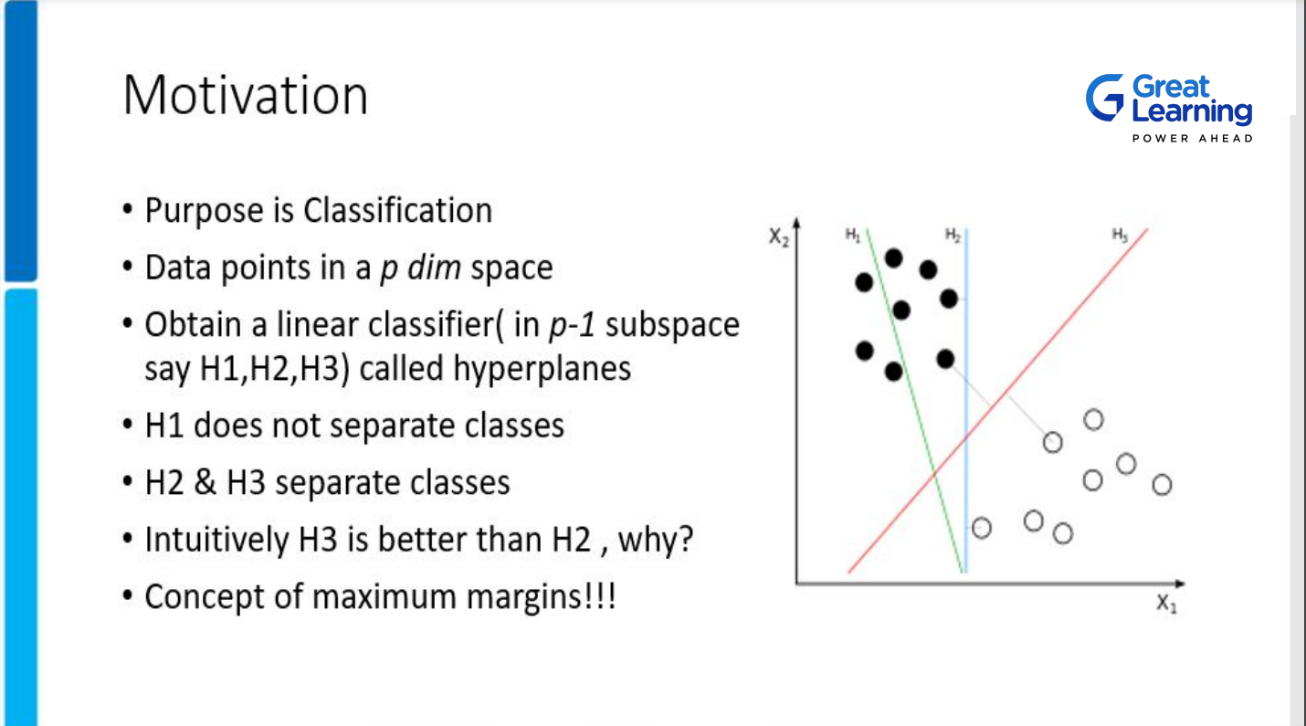
SVM
SVM

Slide 32
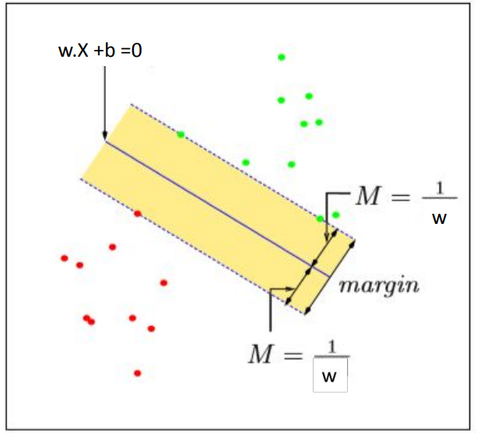
SVM

Slide 33
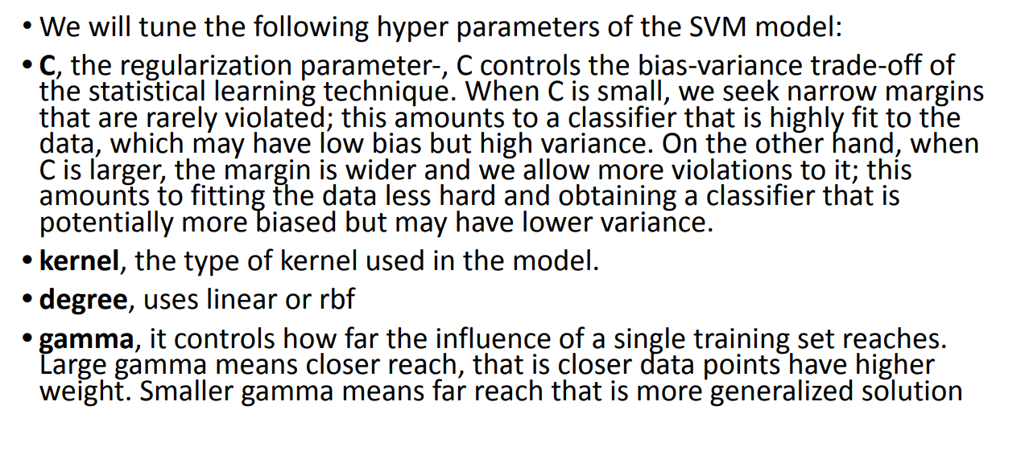
Hyper Parameters ofSVM

Slide 34
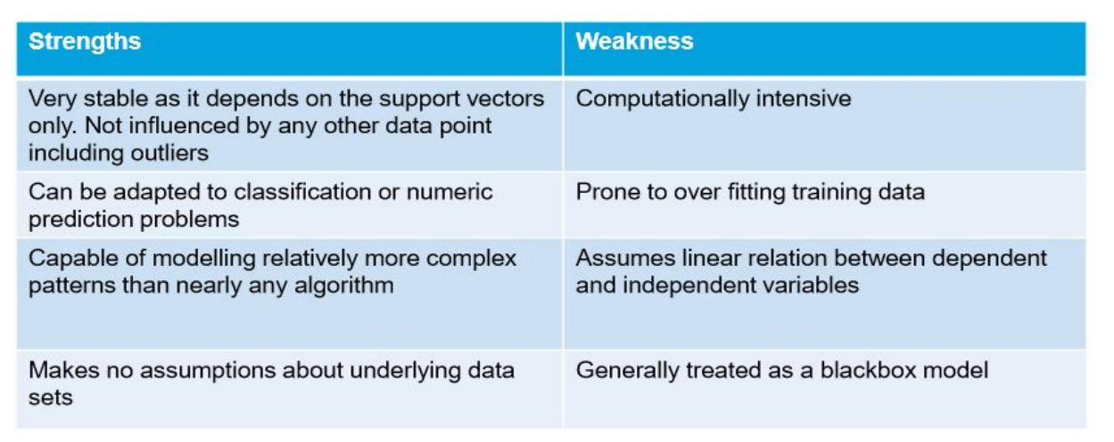
Pros and Cons of SVM

Slide 35
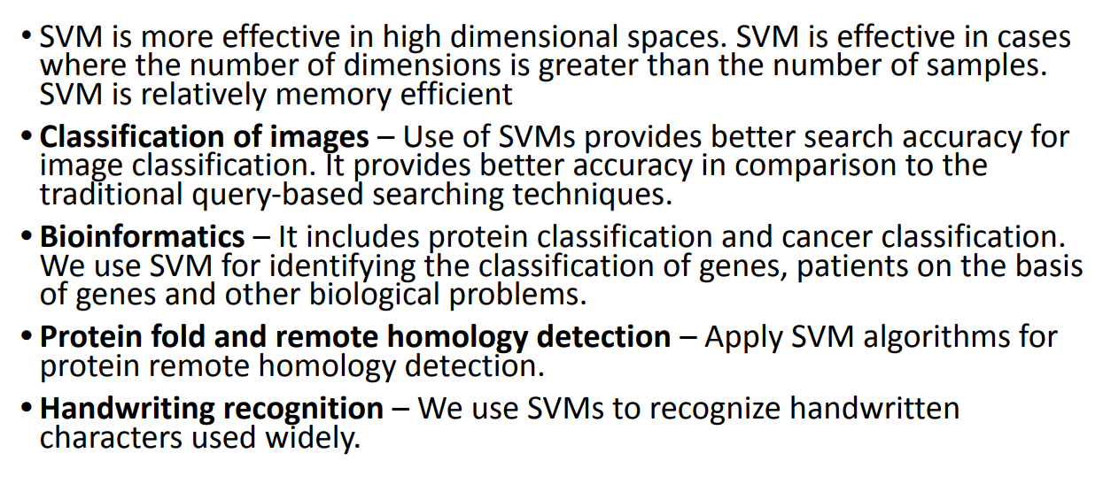
Use Cases of SVM

Slide 36
Prerequisites for ML project
Anaconda Virtual Environment
Git and Github account
Streamlit sharing
VS Code(optional)

Slide 37
Intro to MLOPs

Slide 38
What is ML OPs?
ML OPs is a set of tools and best practices in industry for design , development and deployment of Machine Learning Models to optimize the ML life cycle.
A typical ML Project life cycle has the followings steps
Design
Development
Deployment

Slide 39
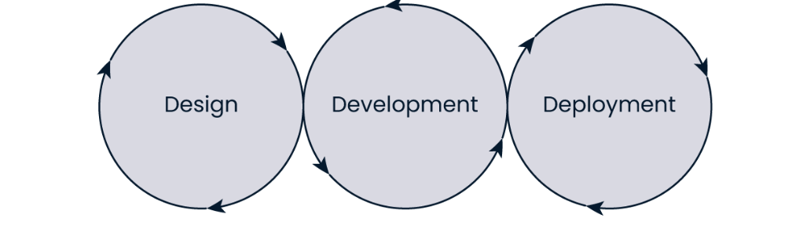
ML OPS Phases

Slide 40
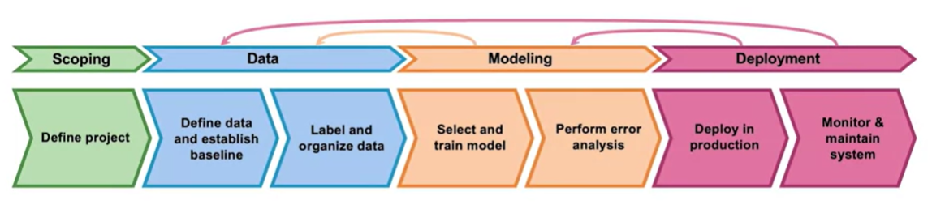
ML OPS LIfe Cycle *
Taken from deeplearning.ai

Slide 41
Virtual Environments
Using virtual environments allows you to avoid installing Python packages globally which could break system tools or other projects
For our deployment projects we will create a new virtual environment in Anaconda as follows:
Open an Anaconda Prompt and type the following code to create a virtual environment of name venv in python version 3.8.13
.
> conda create --name venv python=3.8.13 anaconda
Once done check the venv using
> conda info --envs
Now activate the virtual environment as follows
> activate venv

Slide 42
Intro to Git and Github * ( * https://www.w3schools.com/git/default.asp?remote=github)
What is Git?
Git is a popular version control system. It was created by Linus Torvalds in 2005, and has been maintained by Junio Hamano since then.
It is used for:
Tracking code changes
Tracking who made changes
Coding collaboration
What is GitHub?
Git is not the same as GitHub.
GitHub makes tools that uses Git.
GitHub is the largest host of source code in the world, and has been owned by Microsoft since 2018.

Slide 43
Getting Started with Git and Github
Step1: Sign in for a Github account at https://github.com/ using your email id.
Step2: Get Git on your local computer . For that go to https://git-scm.com/downloads and follow instructions. See the attached documnet to add the SSH keys to Github
Step 3: Once you have got both Github account and Git you are ready to go. For Windows, you can use Git bash, which comes included in Git for Windows. For Mac and Linux you can use the built-in terminal.
Step4: The first thing we need to do, is to check if Git is properly installed. Open Git bash and type the following code
> git --version

Slide 44
Getting Started with Git and Github
Step5:Configure Git
Now let Git know who you are. This is important for version control systems, as each Git commit uses this information:
>git config --global user.name “asdf user"
> git config --global user.email "asdf123@gmail.com"
Note: Use global to set the username and e-mail for every repository on your computer. Also use the same email that you used to register for github.com

Slide 45
Getting Started with Git and Github
Step6: Creating Git Folder
> cd Desktop
> mkdir myprojects
> cd myprojects
mkdir makes a new directory.
cd changes the current working directory.
Now that we are in the correct directory. We can start by initializing Git!
Note: If you already have a folder/directory you would like to use for Git:
Navigate to it in command line, or open it in your file explorer, right-click and select "Git Bash here"

Slide 46
Getting Started with Git and Github
Step7: Initialize Git
Once you have navigated to the correct folder, you can initialize Git on that folder:
> git init
Congrats You just created your first Git Repository!

Slide 47
What is Streamlit ?
Streamlit is a web application framework that helps you to build and develop Python based web applications and can be used to share analytics results , build complex interactive experiences and illustrate new Machine Learning Models
Developing and Deploying Streamlit apps is extremely fast and flexible often turning application development time from days to hours

Slide 48
Why Streamlit
Streamlit helps data scientists to not only build their python machine learning models but deploy them with equal ease to showcase to colleagues and clients
Other options include using frameworks like Flask or Django and then deploy the entire app in AWS or other cloud providers.
On the other hand Streamlit has built-in and convenient methods for taking user input, graphing and using the most popular and powerful Python libraries and quickly deploying web applications.

Slide 49
Installing Streamlit
To install Streamlit run the following code in a anaconda terminal
> pip install streamlit
We can kick off streamlit from command line using the code
> streamlit hello

Slide 50
Streamlit Plotting Demo
We will do the following
Make a Python file where we will house all our Streamlit Code
mkdir plotting_app
cd myfirstapp
type nul > demo.py
Create out plotting demo code
Now open the demo.py using a VS code and type the code for the app

Slide 51
Code for clt.py
import numpy as np
import streamlit as st
import matplotlib.pyplot as plt
st.title("CLT Demo in Streamlit")
st.write("This app simulates a 1000 coin flips, samples with replacement from that population,"
"and then plots the histogram of the means of the samples")
heads=st.number_input('Chance of a head', 0.0, 1.0, 0.5)
binom_dist=np.random.binomial(1,heads, 1000)
sample_means=[]
for i in range(0, 1000) :
sample_means.append(np.random.choice(binom_dist, 100, replace=True).mean())
fig, ax=plt.subplots()
ax=plt.hist(sample_means)
st.pyplot(fig)

Slide 52
Streamlit Plotting Demo
Run our file locally
Open a new anaconda prompt
cd myfirstapp
streamlit run demo.py

Slide 53
Code for pushing clt.py to github
git init
git add .
git status
git commit -m "first commit"
git remote add origin https://github.com/davidgldemo/myfirstapp.git
git push -u origin master

Slide 54
Streamlit Sharing
Streamlit Sharing helps to Deploy, manage, and share your apps with the World directly from Streamlit — all for free.
Streamlit turns data scripts into shareable web apps in minutes.
All in pure Python. No front‑end experience required.
Step1 : Go to https://streamlit.io/
Step2 : Sign up for community Cloud > Get started > Continue with Github

Slide 55
Code for ML Demo in Streamlit
Create a web app using streamlit for Medical Diagnostics
Deploy the App using Streamlit Sharing as a web url
Be sure to create requirements.txt. For that open anaconda prompt and and type the following code
> pip install pipreqs
Next navigate to the directory and type
> pipreqs .
Happy Building Your First App

Slide 56
Hands on Deployment
We will create a medical diagnostic web app by working on the Pima Diabetes Dataset and create a classification model and will deploy it using streamlit
Dependencies
Jupyter Notebook
VS Code
Github account local Git Bash
Streamlit sharing account connected to Github (share.streamlit.io)

Slide 57
Reference Books
Introduction to Statistical Learning by Gareth James (Springer Publications)
Introduction to Machine Learning with Python by Andreas Muller & Sarah Guido (O’Reilly Publication)

Slide 58
Deep Learning Introduction

Slide 59
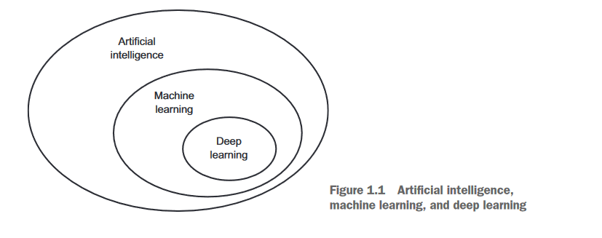
Intro to Deep Learning

Slide 60
Contents
Deep Learning
Computer Vision
Building a Dog Cat Classifier

Slide 61
Deep Learning
Deep Learning is the use of powerful neural networks for prediction tasks
Neural networks account for interactions very well and hence deep learning methods perform very well on a number of prediction tasks such as these
- text
- images
- videos
- audio

Slide 62
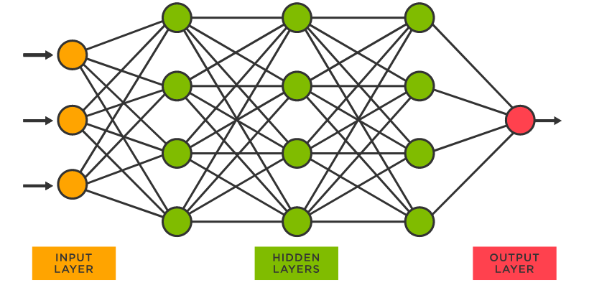
A typical Neural network

Slide 63
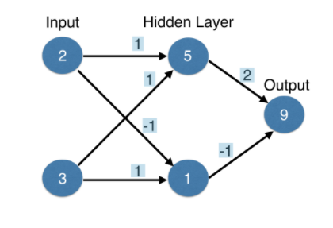
Forward propogation
It is the method used by neural networks to make prediction
Suppose we want to make predictions based on no. Of children & customer’s existing account
Multiply –add process
Dot product
Forward propagation for one data point (one row) at a time
Output is the prediction for that data point

Slide 64
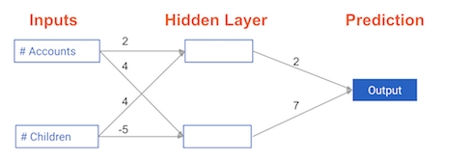
Coding the Forward Neural Network: Calculate the output
Calculate the prediction for input array as [3,2]
The prediction is 42

Slide 65
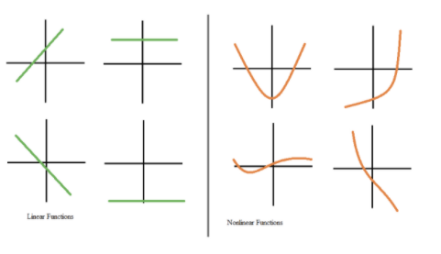
Activation Functions
To optimize the performance of neural networks we need to apply an activation function to each node of the hidden layers
Activation functions allow the model to capture non linearity

Slide 66
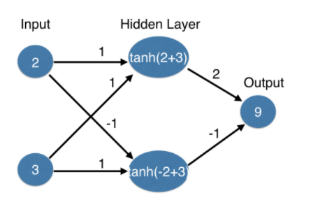
Applying tanh activation functions

Slide 67
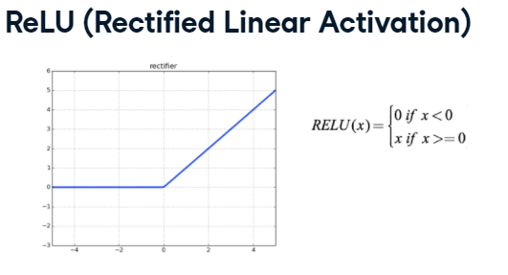
Industry preferred Activation Functions

Slide 68
The relu
The rectified linear activation function (called ReLU) has been shown to lead to very high-performance networks. This function takes a single number as an input, returning 0 if the input is negative, and the input if the input is positive.
Here are some examples: relu(3) = 3 relu(-3) = 0

Slide 69
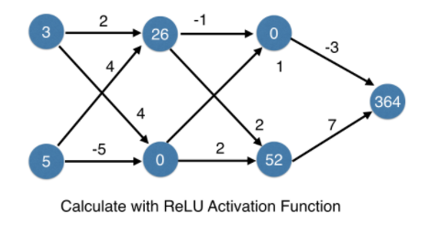
Deeper Networks
These are neural networks having multiple successively placed hidden layers . We could have 2, 3,5 15 etc hidden layers

Slide 70
Deeper Networks
Deeper networks internally build representations of patterns in the data useful for making predictions
Increasingly complex patterns are uncovered as we go through successive hidden layers of the neural network
The "deep" in "deep learning" is not a reference to any kind of "deeper" understanding achieved by the approach, rather, it simply stands for this idea of successive layers of representations—how many layers contribute to a model of the data is called the "depth" of the model.
In deep learning, these layered representations are (almost always) learned via models called "neural networks", structured in literal layers stacked one after the other.

Slide 71
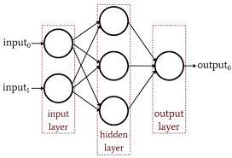
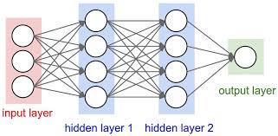
Which Neural Network can capture interactions better
Model 2 has more nodes in the hidden layer, and therefore, greater ability to capture interactions.

Slide 72
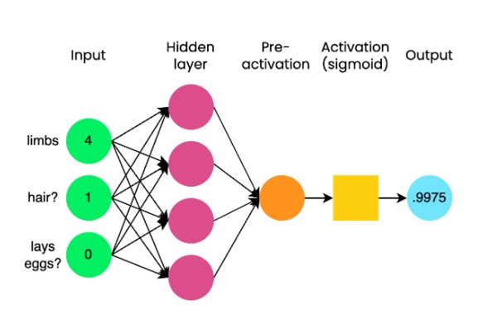
A look at Sigmoid Function
Binary Classification
Animal is a 1(mammal) or 0
(not a mammal)
Sigmoid outputs a probability
Uses a common threshold of 0.5
If output>0.5 —> prediction=1
If output<=0.5 prediction=0
Note: Sigmoid as the last step of a neural network is equivalent to the the traditional logistic regression

Slide 73
Deeper Networks
So they partially replace the need for feature engineering
Also known as representation learning where subsequent layers build increasingly sophisticated representations of the raw data
Modeller doesnt need to specify the interactions
When we train the model the neural networks get weights that find the relevant patterns to make better predictions

Slide 74
What is a forward pass?
The forward pass is when the input layer is passed forward or propagated through all the layers of the network to finally output a ‘prediction’

Slide 75
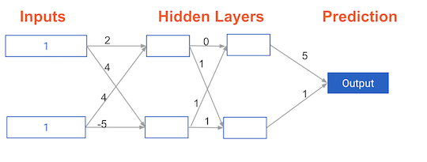
Forward propagation in a deeper network
You now have a model with 2 hidden layers. The values for an input data point are shown inside the input nodes. The weights are shown on the edges/lines. What prediction would this model make on this data point? Assume the activation function at each node is the identity function. That is, each node's output will be the same as its input. So the value of the bottom node in the first hidden layer is -1, and not 0, as it would be if the ReLU activation function was used.

Slide 76

Representations are learned
How are the weights that determine the features/interactions in Neural Networks created?
A) A user chooses them when creating the model.
B) The model training process sets them to optimize predictive accuracy.
C) The weights are random numbers.

Slide 77

Representation levels
Which layers of a model capture more complex or "higher level" interactions?
A) The first layers capture the most complex interactions.
B) The last layers capture the most complex interactions.
C) All layers capture interactions of similar complexity.

Slide 78
What is a backward pass?
It is a complimentary step to the forward pass
Backward pass or back propagation is to update the weights and biases during model training
The ‘training loop’ is also called as Gradient Descent in which:
Propagate data forward to get the output
Compare the output with true values (ground truth) to get the error
Backpropagate to update model weights and biases
Repeat until weights biases are tuned to minimize the error

Slide 79
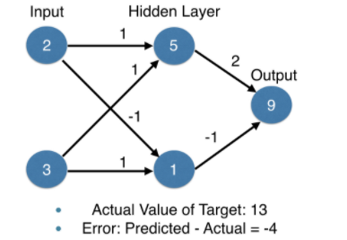
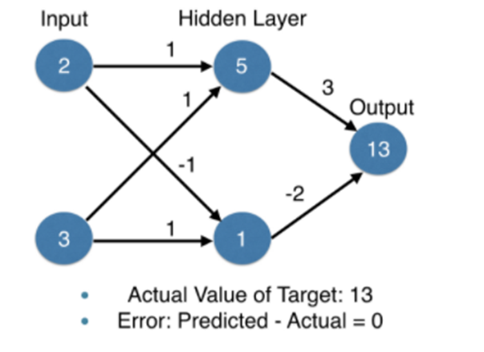
Optimizing the Neural Network
We use backward propagation and Gradient Descent to optimize the network
Consider the network here.
Forward propagation gives an error of -4
Changing the weights will change the prediction
Updating weights in the output layer reduces the error to 0

Slide 80
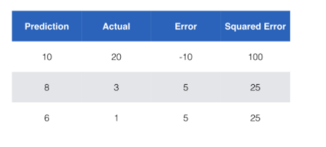
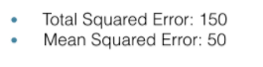
Optimizing neural networks
When we use multiple data points we use a loss function to aggregate the errors made by the model
The common loss function for regression tasks is the mean squared error

Slide 81
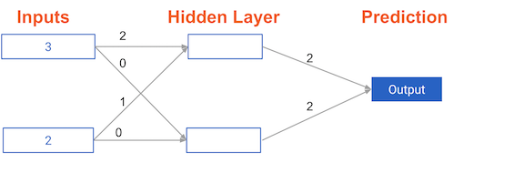
Calculating model errors
What is the error (predicted - actual) for the following network using the ReLU activation function when the input data is [3, 2] and the actual value of the target (what you are trying to predict) is 5?

Slide 82
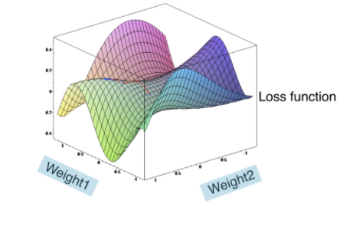
Optimizing neural networks
For optimizing neural networks having multiple weights we use the loss function
Lower loss function means a better modeL
Goal: Find the weights that give lowest value for the loss function
We do it using GRADIENT DESCENT

Slide 83
GRADIENT DESCENT
Using an analogy - imagine you are in itch dark field
- Feel the ground to see how it slopes
- take a small step downhill
- repeat until it is uphill in all directions

Slide 84
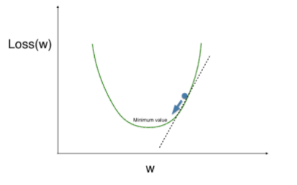
Gradient Descent optimization using a single weight
Gradient descent steps
-- start at a random point
-- find the slope
-- take a step downhill
--until you are somewhere flat

Slide 85
Gradient Descent
If the slope Is positive:
Going opposite the slope means going to smaller numbers
So we subtract the slope from the current value
Too big a step might lead us astray
Solution is learning rate
Update weights by subtracting learning rate * slope
Actual algorithm uses calculus and chain rule

Slide 86
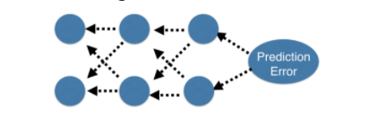
Back Propogation
Allows gradient descent to update all the weights in the neural network ( by getting gradients for all weights)
Important to understand the process but we use library to implement this
Each time you generate predictions using forward propagation, you update the weights using backward propagation.

Slide 87
A round of backpropagation
In the network shown below, we have done forward propagation, and node values calculated as part of forward propagation are shown in white. The weights are shown in black. Layers after the question mark show the slopes calculated as part of back-prop, rather than the forward-prop values. Those slope values are shown in purple.
This network again uses the ReLU activation function, so the slope of the activation function is 1 for any node receiving a positive value as input. Assume the node being examined had a positive value (so the activation function's slope is 1).

Slide 88
Model Optimization
A learning rate that is too low could prevent a model from showing an improved loss in its first few epochs
A very high learning rate could prevent a model from showing an improved loss in its first few epochs
Poor choice of activation function.

Slide 89
Diagnosing optimization problems
Which of the following could prevent a model from showing an improved loss in its first few epochs?
1. Learning rate too low.
2. Learning rate too high
3. Poor choice of activation function.
4. All of the above.

Slide 90
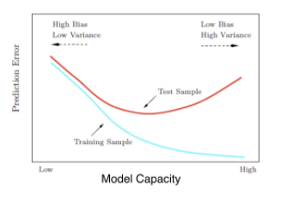
Model Capacity
Closely related to overfitting and under fitting
Validation score is the ultimate measure to check model’s predictive quality

Slide 91
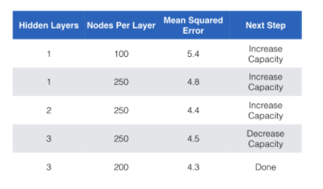
Model Capacity-sequential experiments

Slide 92
Experimenting with model structures
You've just run an experiment where you compared two networks that were identical except that the 2nd network had an extra hidden layer. You see that this 2nd network (the deeper network) had better performance. Given that, which of the following would be a good experiment to run next for even better performance?
Try a new network with fewer layers than anything you have tried yet.
Use more units in each hidden layer.
Use fewer units in each hidden layer.

Slide 93
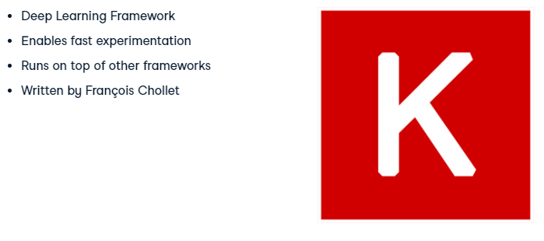
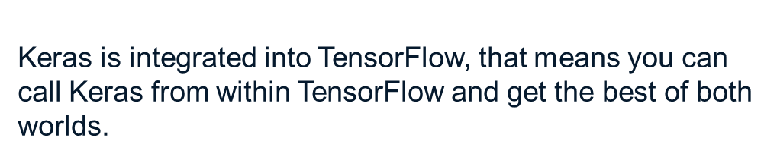
KERAS

Slide 94
Intro to Keras
Keras is a model-level library, providing high-level building blocks for developing deep learning models. It does not handle itself low-level operations such as tensor manipulation and differentiation. Instead, it relies on a specialized, well-optimized tensor library to do so, serving as the "backend engine" of Keras.
Via TensorFlow (or Theano, or CNTK), Keras is able to run on both CPU and GPU seamlessly. When running on CPU, TensorFlow is itself wrapping a low-level library for tensor operations called Eigen. On GPU, TensorFlow wraps a library of well-optimized deep learning operations called cuDNN, developed by NVIDIA.

Slide 95
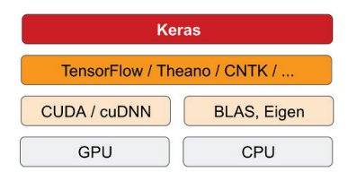
Intro to keras

Slide 96

COMPUTER VISION

Slide 97
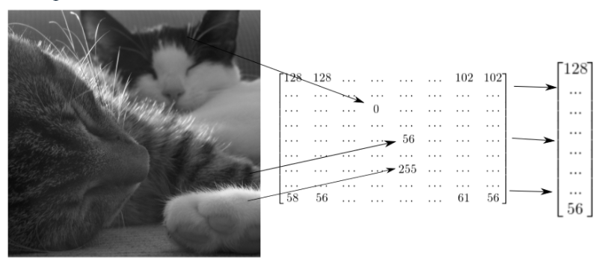
Reshaping- Image classification

Slide 98
4- steps of a Computer Vision Task
Convolution Step
Max Pooling Step
Flattening Step
Fully Connected Step

Slide 99
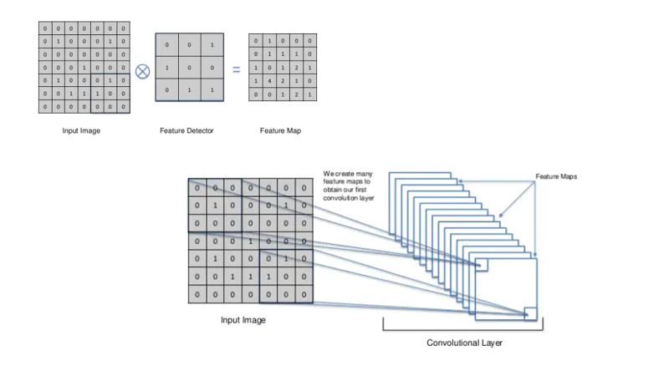

Slide 100
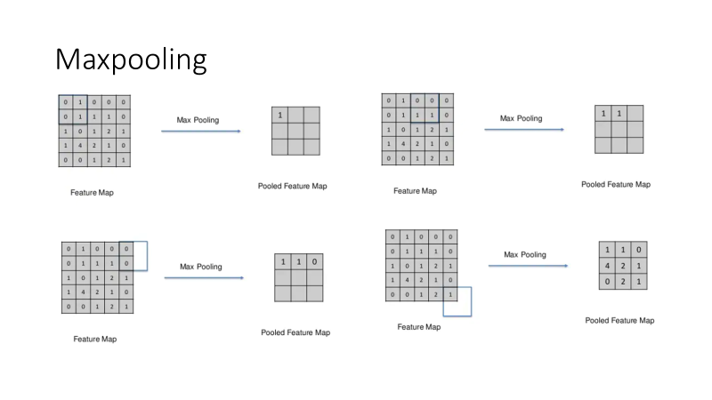

Slide 101
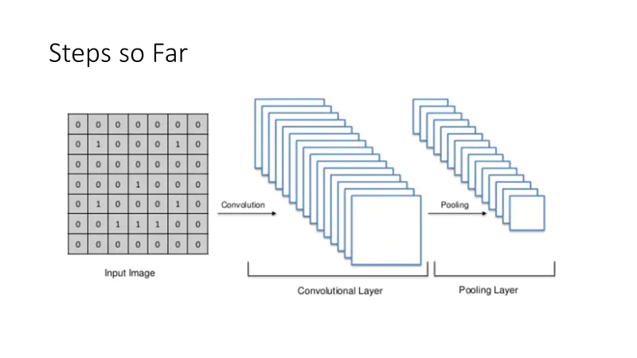

Slide 102
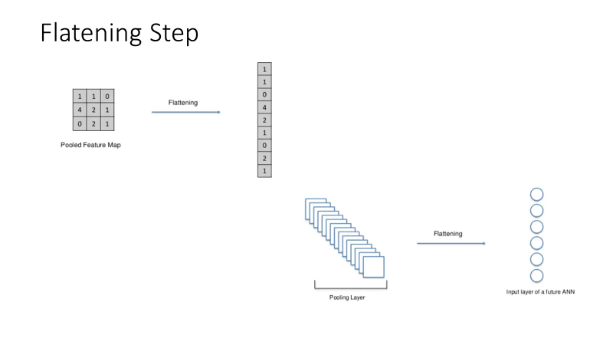

Slide 103
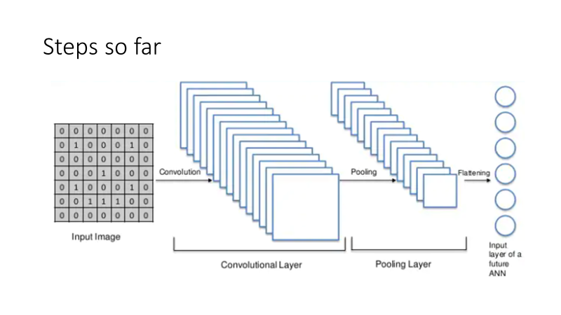

Slide 104
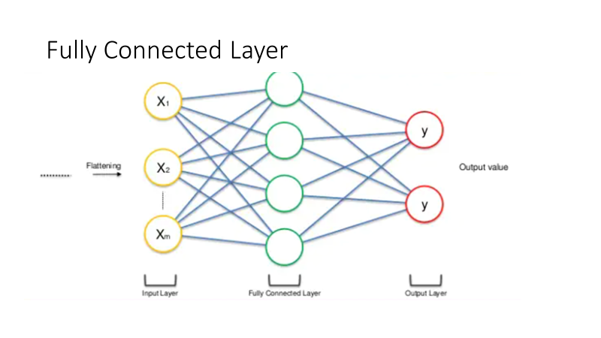

Slide 105
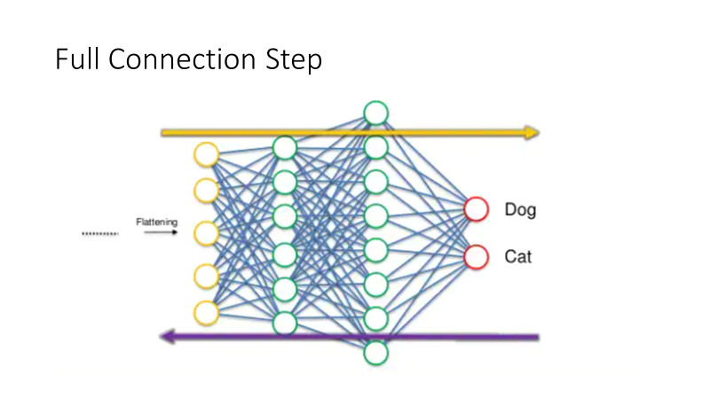

Slide 106
TRAINING A CAT-DOG CLASSIFIER
You will sometimes hear that deep learning only works when lots of data is available. This is in part a valid point: one fundamental characteristic of deep learning is that it is able to find interesting features in the training data on its own, without any need for manual feature engineering, and this can only be achieved when lots of training examples are available. This is especially true for problems where the input samples are very high-dimensional, like images
The cats vs. dogs dataset that we will use isn’t packaged with Keras. It was made available by Kaggle.com as part of a computer vision competition in late 2013, back when convnets weren’t quite mainstream. You can download the original dataset at: www.kaggle.com/c/dogs-vs-cats/data

Slide 107
Training a Dog Cat Classifier
In the cats vs. dogs the Kaggle competition in 2013 was won by entrants who used convnets.
The best entries could achieve up to 95% accuracy. In our own example,
we will be training our models on less than 10% of the data that was available to the competitors.
This original dataset contains 25,000 images of dogs and cats (12,500 from each class) and is 543MB large (compressed). After downloading and uncompressing it, we will create a new dataset containing three subsets: a training set with 1000 samples of each class, a validation set with 500 samples of each class, and finally a test set with 500 samples of each class.

Slide 108
Steps for training a dog cat classifier using a CNN
Step1 : Copying images to training validation and testing directories
Step2: Instantiating a small convent for dogs vs. cats classification
Step3: Configuring the model for training
Step4: Data Preprocessing using ImageDataGenerators from Keras
- Read the picture files
- De`code the JPEG content to RGB grids of pixels
- Convert these to floating point tensors
- Rescale the pixel values (between 0 to 255) to the [0,1] interval
Step5 : Fitting the model using a batch generator
Step6 : Displaying curves of loss and accuracy during training
Step7 : Saving the model

Slide 109
References
Deep Learning with Python by Francois Chollet (Author)

